Slide 1

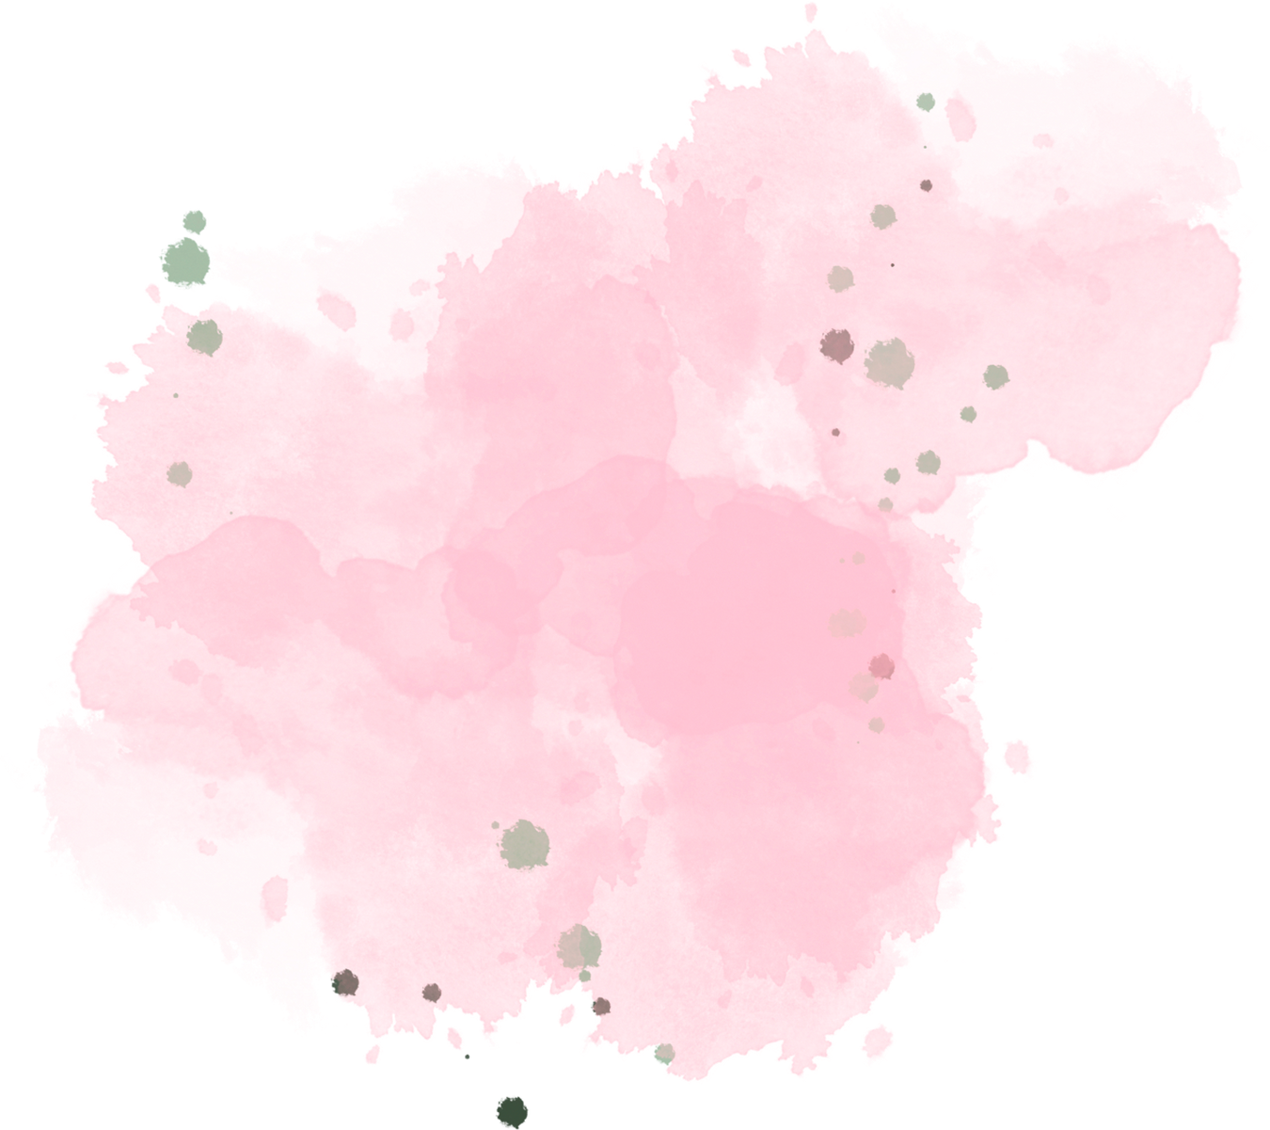
Supply Chain Disruption
Presented by:
AARON SAM.AS

Slide 2



Index
Supply Chain Disruption
objectives
Milestones
Flow diagram
Results
Future use case

Slide 3



Supply chain disruption
Supply Chain Disruption Prediction refers to the process of using data-driven techniques, such as machine learning, to assess potential risks and interruptions in the supply chain.
Businesses face unexpected disruptions due to global events, transportation delays, and supplier issues, leading to inventory shortages or overstocking.
Without predictive insights, companies struggle to optimize inventory levels, resulting in financial losses and operational inefficiencies.
The system analyzes global data (news, supplier reports, transportation trends) using NLP and machine learning to forecast supply chain risks.
Integrating with ERP systems, the model dynamically adjusts stock levels and triggers real-time alerts via Slack or Email for proactive decision-making.

Slide 4
Milestones
Milestone-1
Start gathering preliminary data
from press reports, supplier details.
Milestone-2
Compile information about the
worldwide supply chain in an
organized manner for analysis.
Milestone-3
Create predictive models with
previous data to foresee supply
chain issues in the future..
Milestone-4
To instantly alert teams to
important disruptions or necessary
stock modifications, integrate the
system with Slack or email.

Slide 5
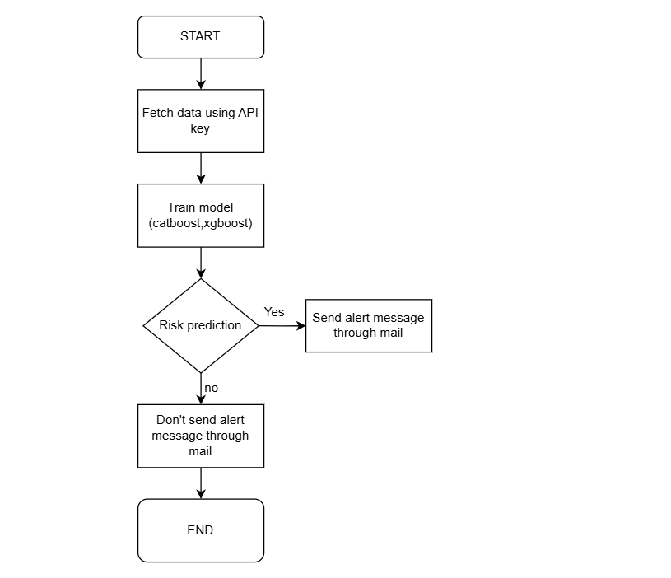
Flow Diagram

Slide 6
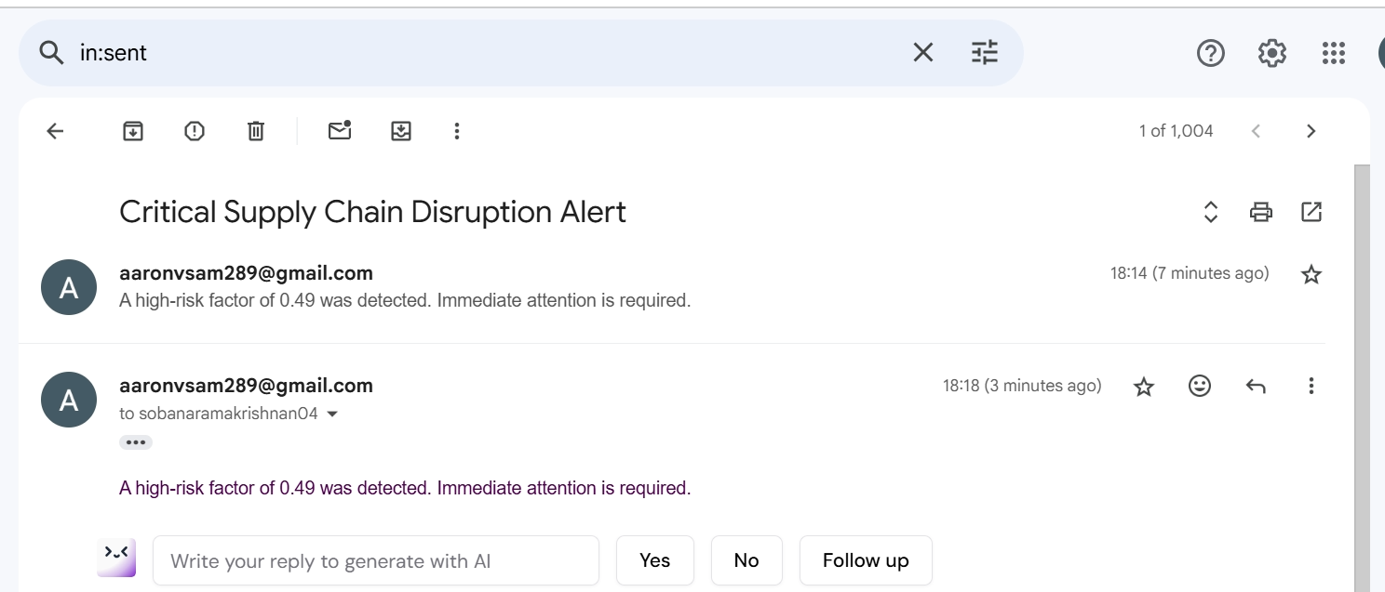
Result
Receive email once risk factor detected

Slide 7
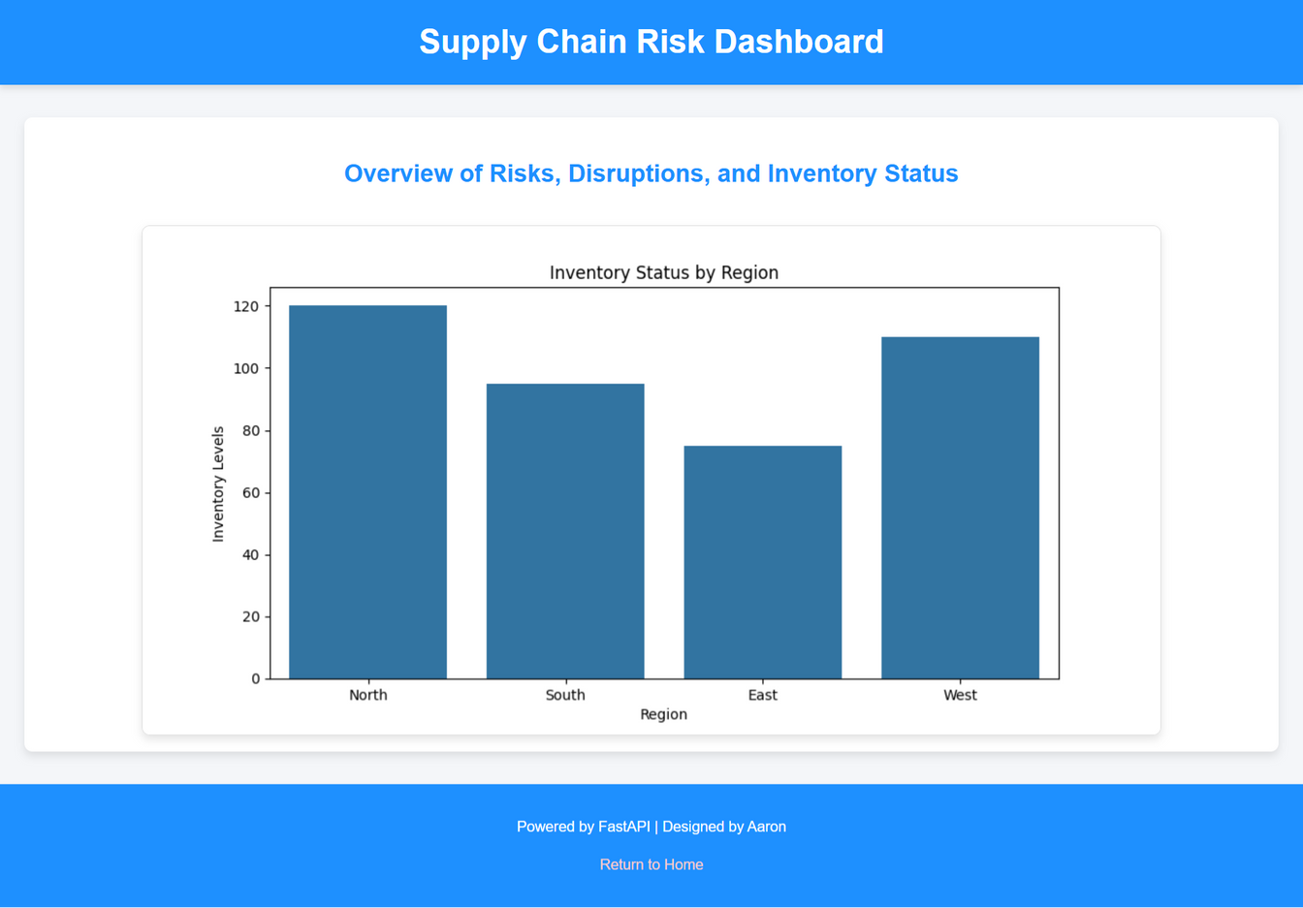
Dashboard

Slide 8
Future Use Case
Integrate IoT sensors to provide live data for accurate risk prediction.
Connect with logistics and supplier systems to auto-adjust inventory and reroute shipments.
Use advanced ML models for predictive analytics and proactive disruption management.
Enhance security and traceability in supply chain operations.
Incorporate external factors like weather, economic conditions, and geopolitical events.

